Slide 1
Will they stay or will they go?
A study in employee attrition with machine learning
Andrew Bankston
Jacob Zacarias
Jenny Randle
Sanabu Washizuka

Slide 2
Overview
Review what characteristics a currently employed team member might have that might imply their departure from an organization
Employer perspective
Online app
Visual data analysis
Machine learning
Predictive modelling

Slide 3
About "Attrition Employees"
An "Attrition Employee" in the context of this study is an employee that will eventually leave the company due to voluntary or involuntary reasons by part of the employee

Slide 4
Attrition Costs
Employee departures have numerous, mostly hidden costs to organizations
Time/monetary cost to hire new employees
Time/monetary cost to train new employees
Low efficacy of new employees
Low company morale > Low efficacy of current teams

Slide 5
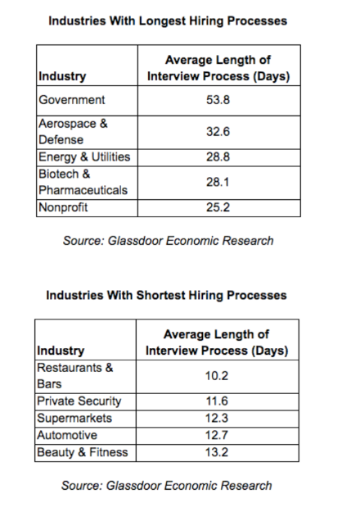
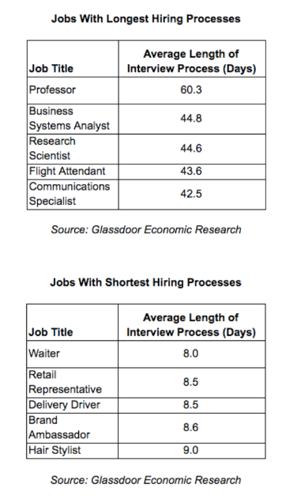
Cost for Hiring
Median hiring process duration across industries: ~32 days
Job function of lost employee displaced onto others
Time taken away from management teams
https://www.glassdoor.com/blog/how-long-should-interviews-take/

Slide 6
Turnover & replacement costs :
per year
-$660,000 to -$2,600,000
Estimates for an organization with:
100 employees
Avg. salary: $50,000 per employee
https://www.gallup.com/workplace/247391/fixable-problem-costs-businesses-trillion.aspx

Slide 7
What to do?
What characteristics of an employee are likely to lead them to be an attrition employee?
Is a specific employee likely to become an attrition employee?
What can I do to help stop employee turnover?

Slide 8
Employee Attrition App
* NOTE: The data set used is a fabricated example created by IBM. The app, data and predictor are not intended to reflect real-world scenarios.

Slide 9
Current Team Member Reviews

Slide 10

Anne
Age: | 34 | Hourly Rate: | 70
Education: | Master's | Job Role | Sales Executive
Distance From Home (miles): | 2 | Gender: | Female
Job Involvement: | High | Business Travel: | Travel Rarely

Slide 11
Josh
Age: | 28 | Hourly Rate: | 35
Education: | Bachelor's | Job Role | Laboratory Technician
Distance From Home (miles): | 29 | Gender: | Male
Job Involvement: | High | Business Travel: | Travels Frequently

Slide 12
Prediction Algorithm Demo

Slide 13
What to do?
Listen and Discuss:
Distance From Home: How does the employee feel about their commute?
Job Involvement / Job Role: How does the employee feel about how they are contributing to the team?
Hourly Rate: Does the employee feel their compensation is misvalued?
Business Travel: How is the employee feeling about their travel? Do they want more? Less?

Slide 14
THANK YOU
GitHub Link

Slide 15
Credits
(2017). IBM HR Analytics Employee Attrition & Performance. https://www.kaggle.com/pavansubhasht/ibm-hr-analytics-attrition-dataset | (2021). Vecteezy. https://www.vecteezy.com
(2020). End-to-End Machine Learning Project Tutorial — Part 1. https://dswharshit.medium.com/end-to-end-machine-learning-project-tutorial-part-1-ea6de9710c0 | (2017). How Long Should Your Interview Process Take? We Found Out. https://www.glassdoor.com/blog/how-long-should-interviews-take/
(2021). Soft UI Dashboard. https://www.creative-tim.com/product/soft-ui-dashboard | (2019). This Fixable Problem Costs U.S. Businesses $1 Trillion. https://www.gallup.com/workplace/247391/fixable-problem-costs-businesses-trillion.aspx
(2021). Slides Carnival. https://www.slidescarnival.com/

